Slide 1

Database Management Systems
Module-1: Introduction to
Database Concepts and Architecture
Dr. Chethan B K

Slide 2
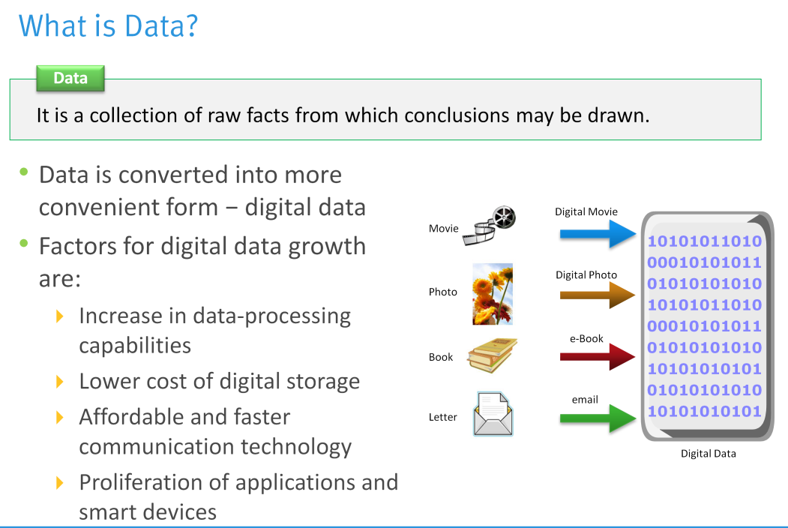

Slide 3
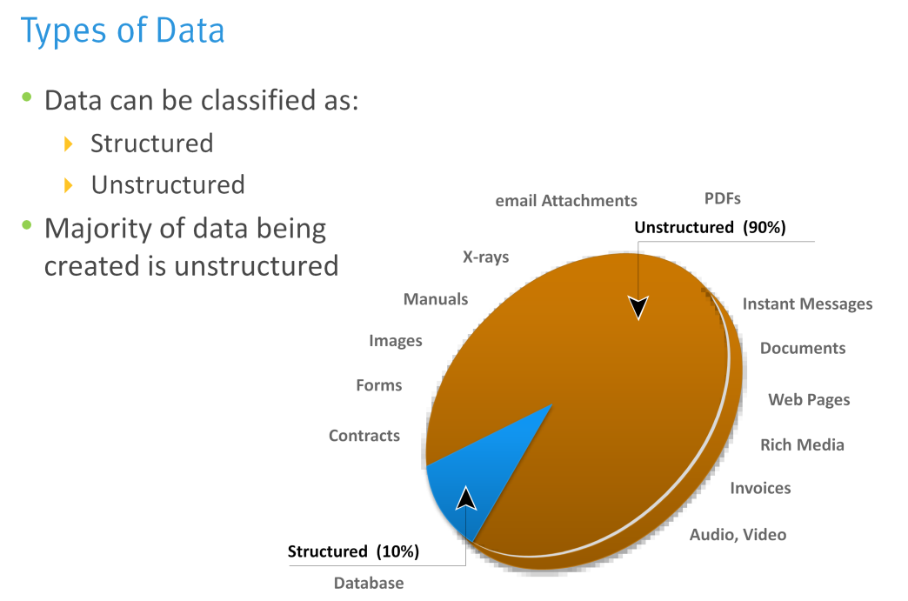

Slide 4
Introduction - Basic Definitions
Database: A collection of related data.
Data: Known facts that can be recorded and have an implicit meaning.
Information: Knowledge acquired from the data.
Mini-world: Some part of the real world about which data is stored in a database. For example, student grades and transcripts at a university.
Database Management System (DBMS): A software package/ system to facilitate the creation and maintenance of a computerized database.
Database System: The DBMS software together with the data itself. Sometimes, the applications are also included.

Slide 5
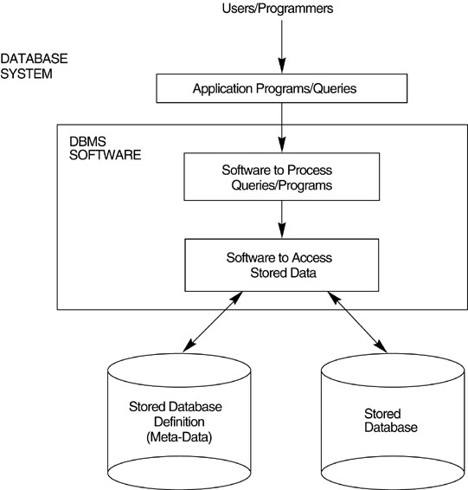
Introduction - Simplified Database System Environment

Slide 6
Examples
Numeric and Textual Databases / Traditional Databases.
Multimedia Databases.
Geographic Information Systems (GIS).
Data Warehouses ( OLAP – Online Analytical Processing).
Real-time and Active Databases.
Big data Storage Systems or NoSQL Systems.
Slide 1-6

Slide 7
Example – University Database
Mini-world for the example: Part of a UNIVERSITY environment.
Some mini-world entities:
  STUDENTs
  COURSEs
  SECTIONs (of COURSEs)
  (academic) DEPARTMENTs
  INSTRUCTORs
Note: The above could be expressed in the ENTITY-RELATIONSHIP data model.

Slide 8
Example – University Database
Some mini-world relationships:
  SECTIONs are of specific COURSEs
  STUDENTs take SECTIONs
  COURSEs have prerequisite COURSEs
  INSTRUCTORs teach SECTIONs
  COURSEs are offered by DEPARTMENTs
  STUDENTs major in DEPARTMENTs
Note: The above could be expressed in the ENTITY-RELATIONSHIP data model.

Slide 9
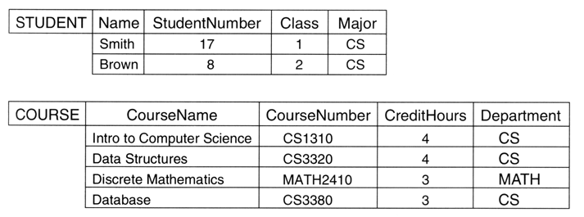
Example - A database that stores student and course information.

Slide 10
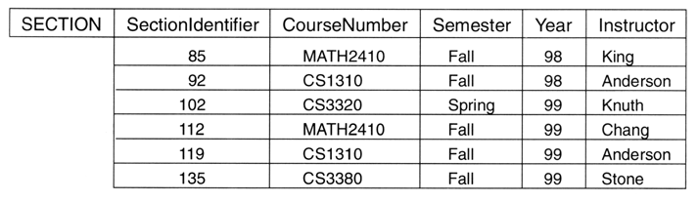
Example - A database that stores student and course information.

Slide 11
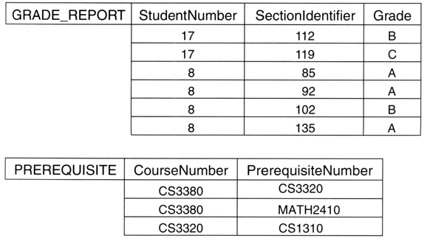
Example - A database that stores student and course information.

Slide 12
Characteristics of the Database Approach
Self-describing nature of a database system: A DBMS catalog stores the description of the database. The description is called meta-data). This allows the DBMS software to work with different databases.
Insulation between programs and data: Called program-data independence. Allows changing data storage structures and operations without having to change the DBMS access programs.

Slide 13
Characteristics of the Database Approach
Data Abstraction: A data model is used to hide storage details and present the users with a conceptual view of the database.
Support of multiple views of the data: Each user may see a different view of the database, which describes only the data of interest to that user.

Slide 14
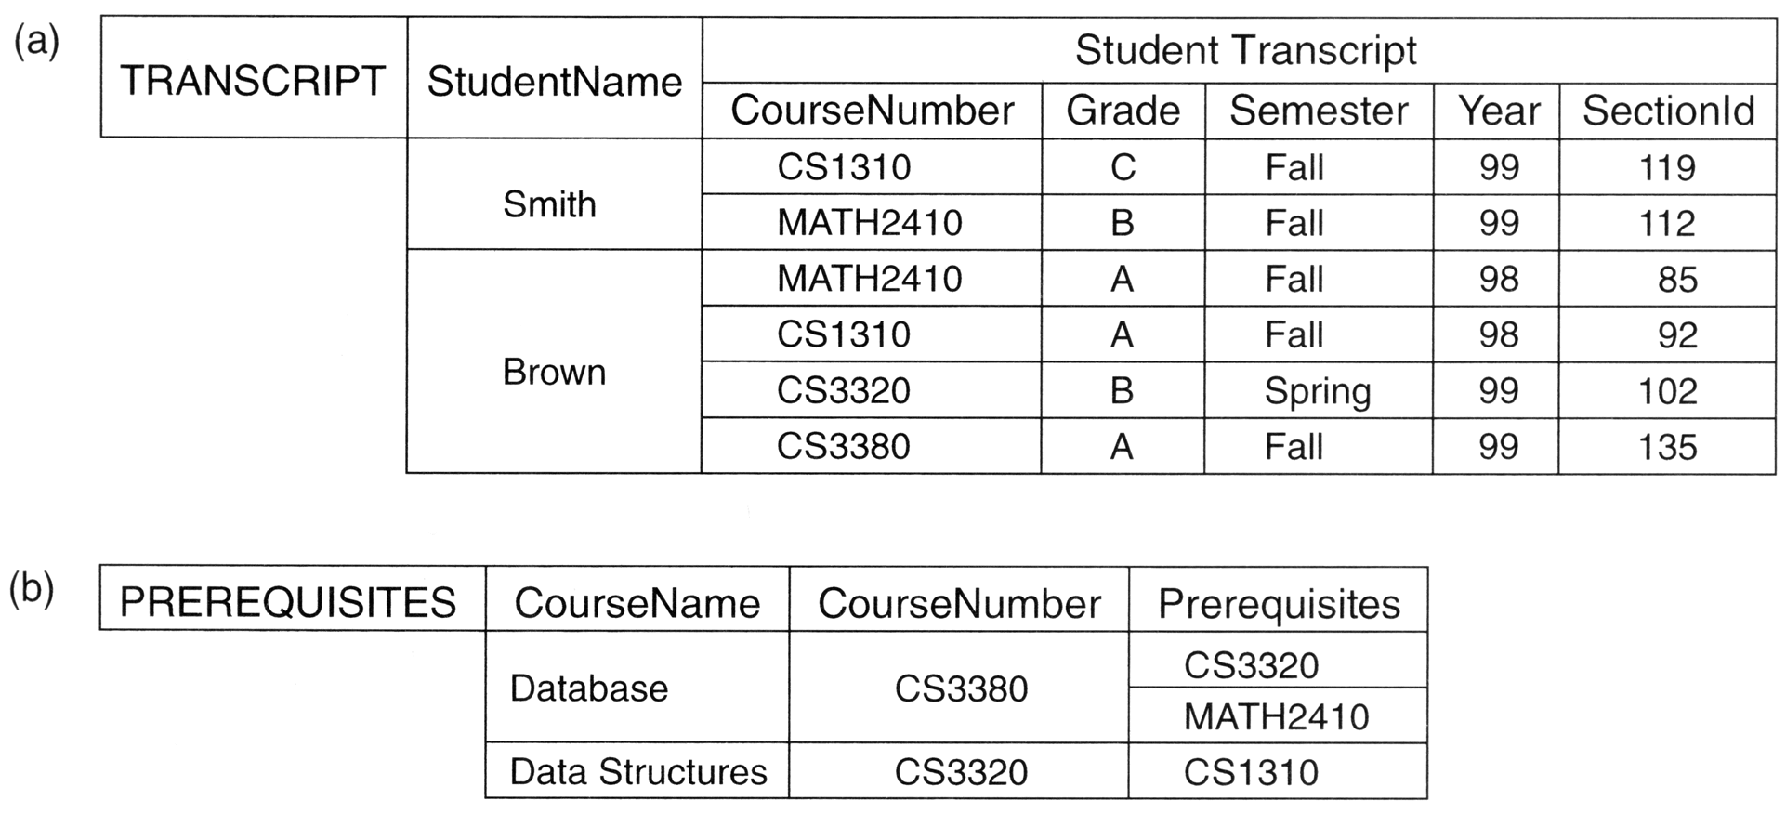
Characteristics of the Database Approach

Slide 15
Characteristics of the Database Approach
Sharing of data and multiuser transaction processing : allowing a set of concurrent users to retrieve and to update the database. Concurrency control within the DBMS guarantees that each transaction is correctly executed or completely aborted. OLTP (Online Transaction Processing) is a major part of database applications.

Slide 16
Advantages of Using the Database Approach
Controlling Redundancy.
Restricting Unauthorized Access to data.
Providing Persistent Storage for Program Objects.
Providing Storage Structures and Search Techniques for Efficient Query Processing.
Providing Backup and Recovery.

Slide 17
Advantages of Using the Database Approach
Providing Multiple User Interfaces.
Representing Complex Relationships among Data.
Enforcing Integrity Constraints.
Permitting Inferencing and Actions Using Rules and Triggers.

Slide 18
Typical DBMS Functionality
Define a database : in terms of data types, structures and constraints.
Construct or Load the Database on a secondary storage medium.
Manipulating the database : querying, generating reports, insertions, deletions and modifications to its content.
Concurrent Processing and Sharing by a set of users and programs – yet, keeping all data valid and consistent.
Protection or Security measures to prevent unauthorized access.
“Active” processing to take internal actions on data.
Presentation and Visualization of data.

Slide 19
Database Users
Users may be divided into
  Those who actually use and control the database content, and those who design, develop and maintain database applications (called “Actors on the Scene”), and
  Those who design and develop the DBMS software and related tools, and the computer systems operators (called “Workers Behind the Scene”).

Slide 20
Database Users – Actors on the Scene
Actors on the scene
  Database administrators:
    Responsible for authorizing access to the database, for coordinating and monitoring its use, acquiring software and hardware resources, controlling its use and monitoring efficiency of operations.
  Database Designers:
    Responsible to define the content, the structure, the constraints, and functions or transactions against the database. They must communicate with the
end-users and understand their needs.

Slide 21
Database End Users
Actors on the scene (continued)
  End-users: They use the data for queries, reports and some of them update the database content. End-users can be categorized into:
    Casual: access database occasionally when needed
    Naïve or Parametric: they make up a large section
of the end-user population.
      They use previously well-defined functions in the form of “canned transactions” against the database.
      Users of Mobile Apps mostly fall in this category
      Bank-tellers or reservation clerks are parametric users who do this activity for an entire shift of operations.
      Social Media Users post and read information from
Copyright © 2016 Rwameez Eblmsasirti eandsShamkant B. Navathe
Slide 1- 22

Slide 22
Database End Users (continued)
Sophisticated:
  These include business analysts, scientists, engineers, others thoroughly familiar with the system capabilities.
  Many use tools in the form of software packages that work
closely with the stored database.
Stand-alone:
  Mostly maintain personal databases using ready-to-use packaged applications.
  An example is the user of a tax program that creates its own internal database.
  Another example is a user that maintains a database of personal photos and videos.

Slide 23
Database Users – Actors on the Scene (continued)
System Analysts and Application Developers
This category currently accounts for a very large proportion of the IT work force.
  System Analysts: They understand the user requirements of naïve and sophisticated users and design applications including canned transactions to meet those requirements.
  Application Programmers: Implement the specifications developed by analysts and test and debug them before deployment.
  Business Analysts: There is an increasing need for such people who can analyze vast amounts of business data and real-time data (“Big Data”) for better decision making related to planning, advertising, marketing etc.

Slide 24
Database Users – Actors behind the Scene
System Designers and Implementors: Design and implement DBMS packages in the form of modules and interfaces and test and debug them. The DBMS must interface with applications, language compilers, operating system components, etc.
Tool Developers: Design and implement software systems called tools for modeling and designing databases, performance monitoring, prototyping, test data generation, user interface creation, simulation etc. that facilitate building of applications and allow using database effectively.
Operators and Maintenance Personnel: They manage the actual running and maintenance of the database system hardware and software environment.

Slide 25
When not to use a DBMS
Main inhibitors (costs) of using a DBMS:
  High initial investment and possible need for additional hardware.
  Overhead for providing generality, security, concurrency control, recovery, and integrity functions.
When a DBMS may be unnecessary:
  If the database and applications are simple, well defined, and not expected to change.
  If access to data by multiple users is not required.
When a DBMS may be infeasible:
  In embedded systems where a general purpose DBMS may not fit in available storage

Slide 26
When not to use a DBMS
When no DBMS may suffice:
  If there are stringent real-time requirements that may not be met because of DBMS overhead (e.g., telephone switching systems)
  If the database system is not able to handle the complexity of data because of modeling limitations (e.g., in complex genome and protein databases)
  If the database users need special operations not supported by the DBMS (e.g., GIS and location based services).

Slide 27

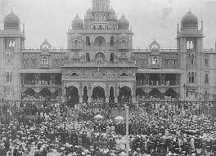


Slide 28



Slide 29
Thank you..

